Slide 1
Market Analysis – Brewery and Beer Data
O’Neal Gray, David Laurel
DS 6306-401 – Doing Data Science
February 21, 2023

Slide 2

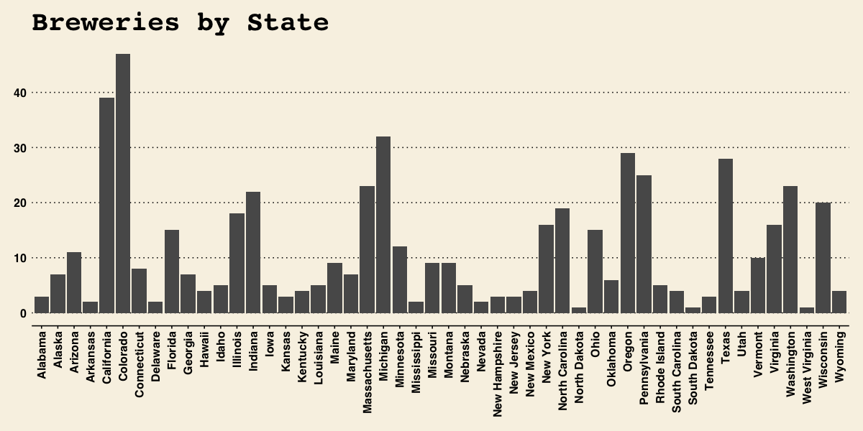
Breweries by State
Top 5
Count | State
47 | Colorado
39 | California
32 | Michigan
29 | Oregon
28 | Texas
Notes:
There are 558 breweries in our data set, and the top 5 states compromises of 31% of the breweries (175).

Slide 3
Dealing with Missing Values
ABV | IBU
Min: 0.00100 | Min: 4.00
1st Qu: 0.05000 | 1st Qu: 21.00
Median: 0.05600 | Median: 35.00
Mean: 0.05977 | Mean: 42.71
3rd Qu: 0.06700 | 3rd Qu: 64.00
Max: 0.12800 | Max: 138.00
Na’s: 62 | Na’s:1005
Determined ABV and IBU to have missing data
Based on this, we decided to fill in ABV data first, as this held a smaller missing dataset, then IBU with predictive- mean imputation
Using the mice package, we’re able to do multivariate imputations
Unsure how to specify ABV as a predictor for IBU or vice versa

Slide 4


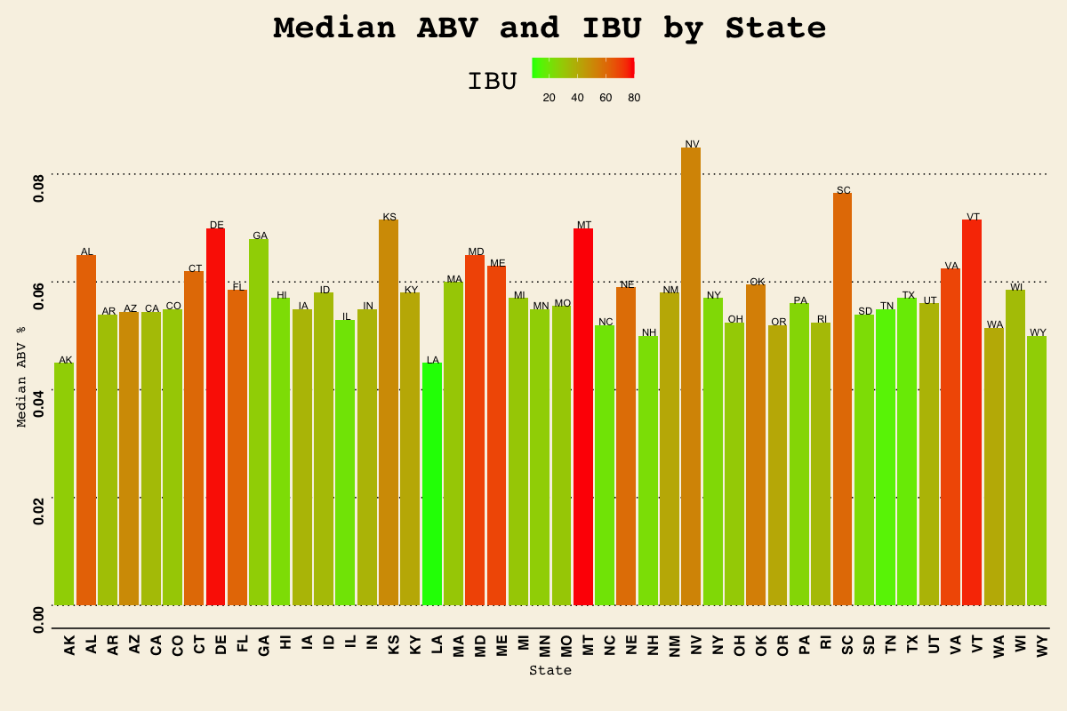

Notes:
Top 3 for IBU, Montana (80), Delaware (77.5), Vermont(75), top 3 for median ABV = Nevada (.085), South Carolina (.0765), and Vermont (.0715) & Kansas (.0715)

Slide 5
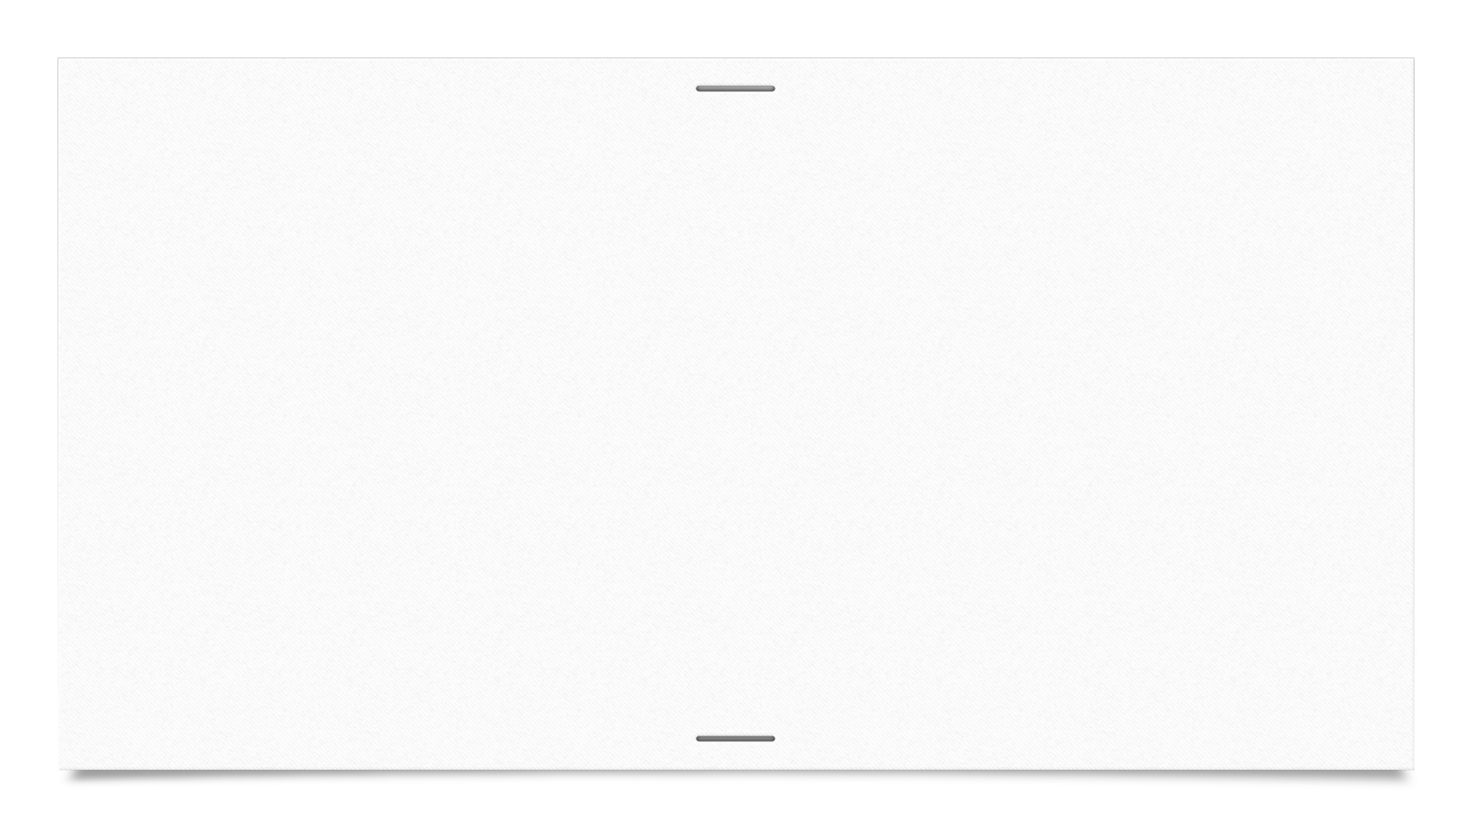

Maximum ABV
Brew ID | Brew Name | City | State | Beer Name | Beer ID | ABV | IBU | Style | Ounces
52 | Upslope Brewing Company | Boulder | CO | Lee Hill Serier Vol 5 | 2565 | 0.128 | NA | Quadrupel | 19.2
2 | Against the Grain Brewery | Louisville | KY | London Balling | 2685 | 0.125 | 80 | English Barleywine | 16.0
18 | Tin Man Brewing Company | Evansville | IN | Csar | 2621 | 0.120 | 90 | Russian Imperial Stout | 16.0
52 | Upslope Brewing Company | Boulder | CO | Leen Hil Series Vol 5 | 2564 | 0.104 | NA | Rye Beer | 19.2
47 | Sixpoint Craft Ales | Brooklyn | NY | 4Beans | 2574 | 0.100 | 52 | Baltic Porter | 12.0
11 | Brewery Vivant | Grand Rapids | MI | Wizard Burial Ground | 2137 | 0.099 | NA | Quadrupel | 16.0
We could calculate the maximum ABV value with the given data, but there appeared to be more to the story than simple maximums
We calculated the five states with the highest scoring ABV beers from the incomplete, original data (to make sure no made-up data was counted), as there was only one repeat (CO) in the top six candidates:
From here, we determined that the beer with the greatest Alcohol by Volume was Colorado’s "Lee Hill Series Vol. 5 - Belgian Style Quadrupel Ale"

Slide 6
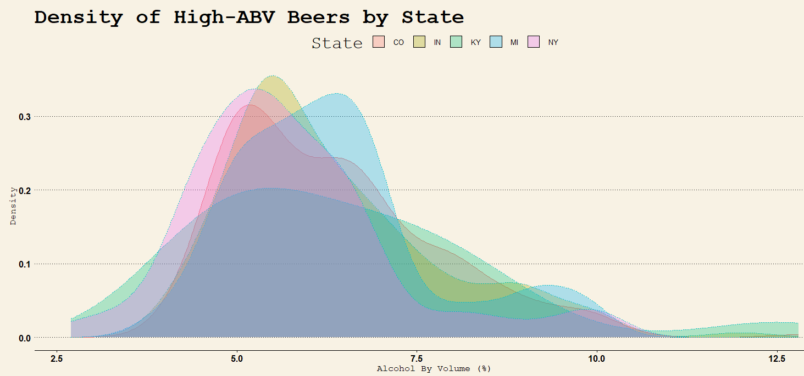
Maximum ABV (cont.)
However, when we attempted to see the distribution of ABV by state, Kentucky had significantly more beers at the top end of the distribution than any of the other states in the top five:

Slide 7
Maximum IBU
Brew ID | Brew Name | City | State | Beer Name | Beer ID | ABV | IBU | Style | Ounces
375 | Astoria Brewing Company | Astoria | OR | Bitter Bitch Imperial IPA | 980 | 0.082 | 138 | American Double/IPA | 12
345 | Wolf Hills Brewing Company | Abingdon | VA | Troopers Alley IPA | 1676 | 0.059 | 135 | American IPA | 12
231 | Cape Ann Brewing Company | Gloucester | MA | Dead-Eye DIPA | 2067 | 0.090 | 130 | American Double/IPA | 16
100 | Christian Moerlein Brewing Company | Cincinnati | OH | Bay of Bengal Double IPA | 2440 | 0.089 | 126 | American Double/IPA | 12
62 | Surly Brewing Company | Brooklyn Center | MN | Abrasive Ale | 15 | 0.097 | 120 | American Double/IPA | 16
273 | The Alchemist | Waterbury | VT | Heady Topper | 1111 | 0.080 | 120 | American Double/IPA | 16
A similar story could be told with IBU; however, the missing data would be more significant in this instance:
The highest-ranking IBU beer was aptly titled “Bitter Bitch Imperial IPA” from Oregon

Slide 8
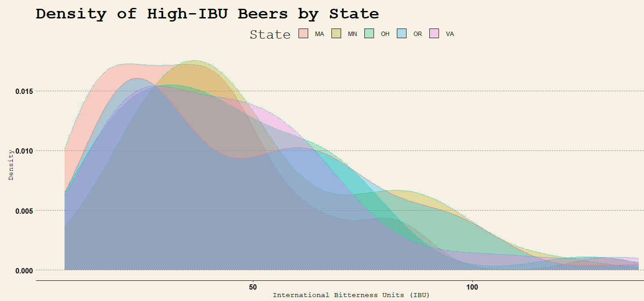
Maximum IBU (cont.)
Again, we see a disparity between density of beers-per-state at the high-end of the IBU spectrum, and the state with the winning IBU beer:

Slide 9
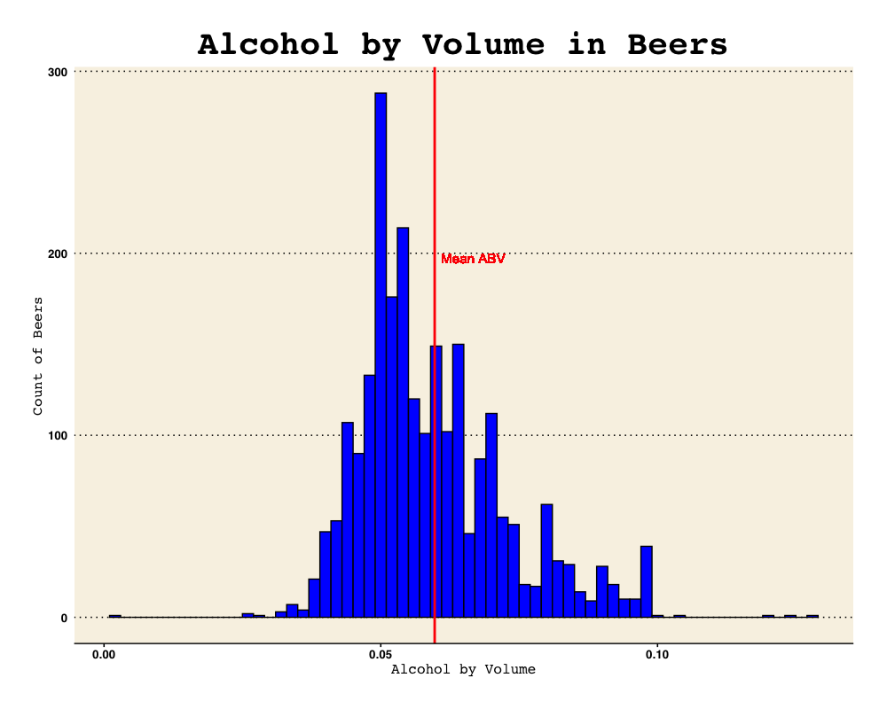
Alcohol By Volume Summary
Min | 1st Qu. | Median | Mean | 3rd Qu. | Max
0.00100 | 0.05000 | 0.05600 | 0.05974 | 0.06700 | 0.12800
Notes:
2,410 beer in our data set, right-tailed plot (mean is greater than the median). Our mean alcohol content for all the bears was 5.97%, and the median ABV was 5.60%.

Slide 10
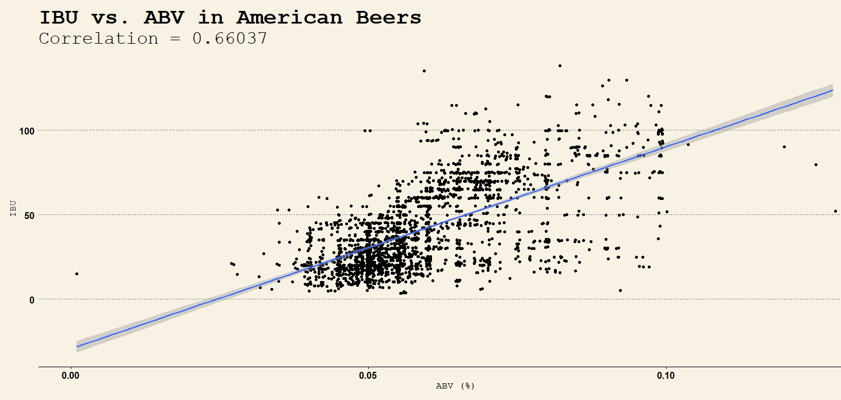
ABV/IBU Compared
There is a clear relationship between ABV and IBU as noted earlier
This relationship could assist in imputing missing column value in either column:

Slide 11

ABV/IBU Compared (cont.)
Interestingly, we see a wall at ABV=10%, where many states have historically set boundaries¹ on sales and distribution for higher alcohol-content beverages:

Slide 12
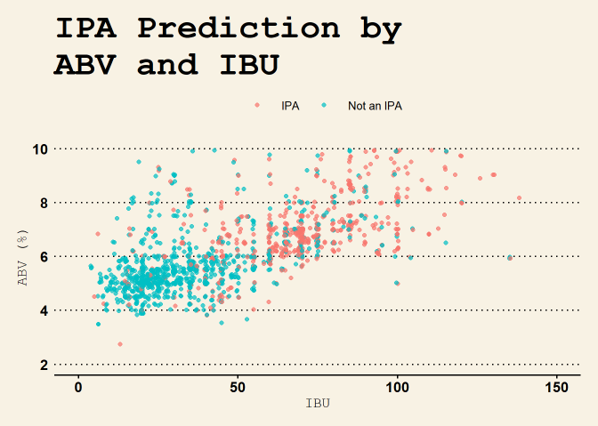
Predicting Ales and IPAs
Using K-Nearest Neighbors, able to predict IPAs and non-IPAs with 79.6% accuracy:
Confusion Matrix and Statistics
Prediction | False | True
False | 250 | 49
True | 45 | 116
Accuracy | 0.7957
95% CI | (0.7559, 0.8319)
No Information Rate | 0.6413
P-Value [Acc > NIR] | 4.129e-13

Slide 13
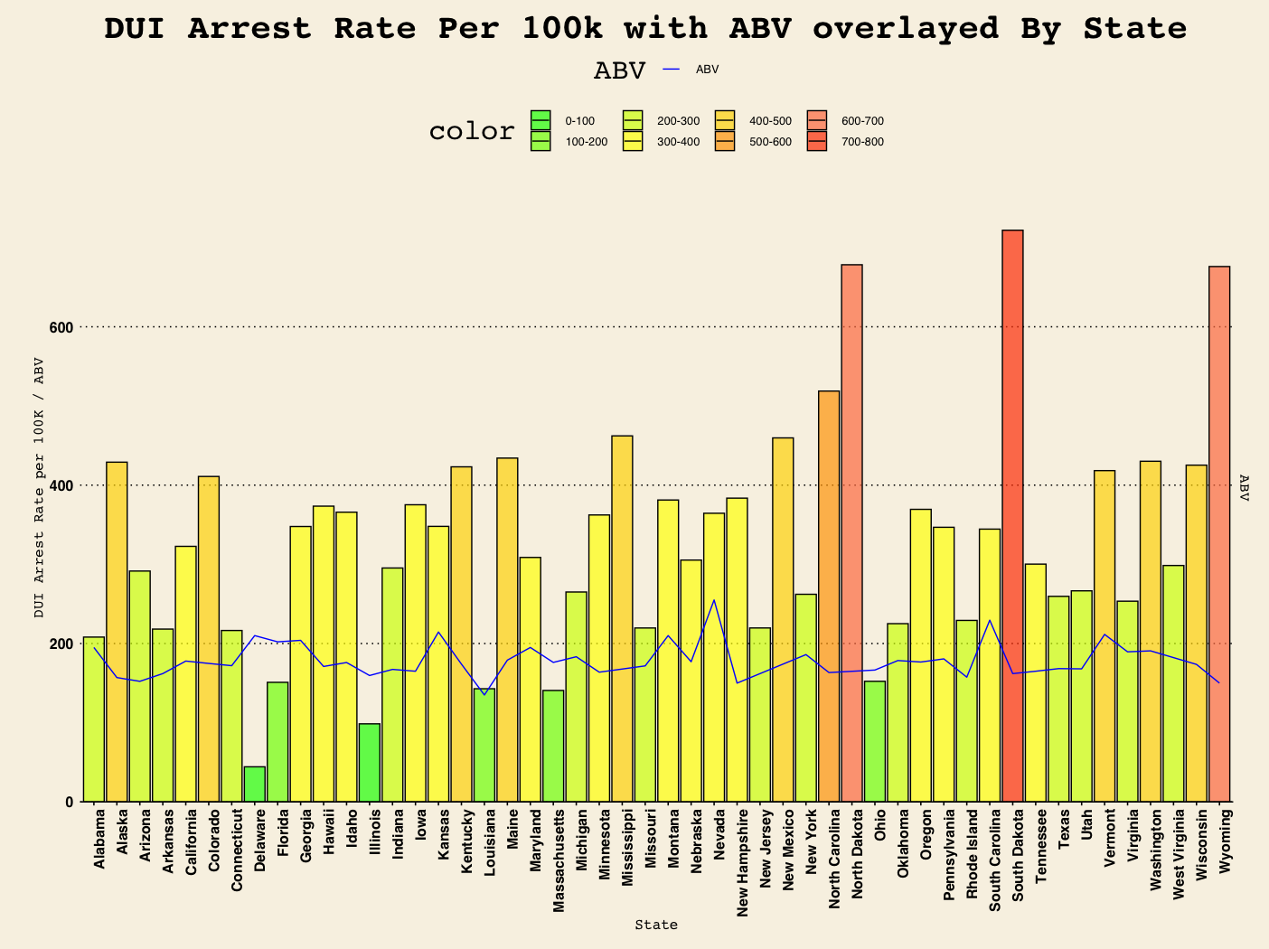
Notes:
Top 3 for IBU, Montana (80), Delaware (77.5), Vermont(75), top 3 for median ABV = Nevada (.085), South Carolina (.0765), and Vermont (.0715) & Kansas (.0715)

Slide 14
Questions?
https://github.com/DHLaurel/DoingDataScience/blob/master/BeersAndBreweries/README.md
Please reach out to:
O’Neal Gray
(214) 724-2020
ogray@mail.smu.edu
David Laurel
(956) 635-6463
dlaurel@mail.smu.edu

Slide 15
References
https://reason.com/2021/09/20/why-is-this-beer-banned-in-15-states/
https://backgroundchecks.org/which-states-have-the-worst-dui-problems.html

